Slide 1



Tool Name_Project Name
FS’tival-22 Software Freedom Day

Slide 2
Problem Statement
To design an UI for a e-commerce website which works on rental method i.e.,
Allows us to rent a product and to get a product in rent.

Slide 3
Objective
To develop a e-commerce website such that it a website where people can could rent their products and also use others products.
The first page consists of login credentials for user security.
After login the users could view the product what are the things they will to rent and use for certain period of time.
Lessor is where user could post in the website with the required details and rent his/her product for specified amount of time.
Lessee is where the use could view his product which he is currently using and needs to be returned.

Slide 4
Tech Stack
React js
Tailwind css
Node js
Mongo db

Slide 5
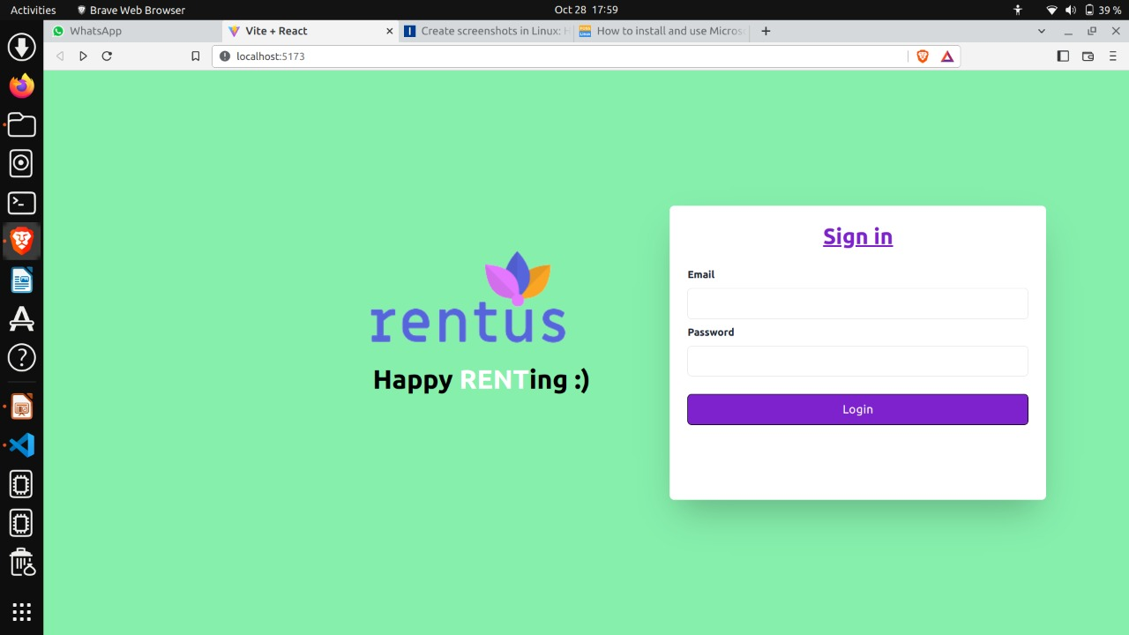
Modules

Slide 6
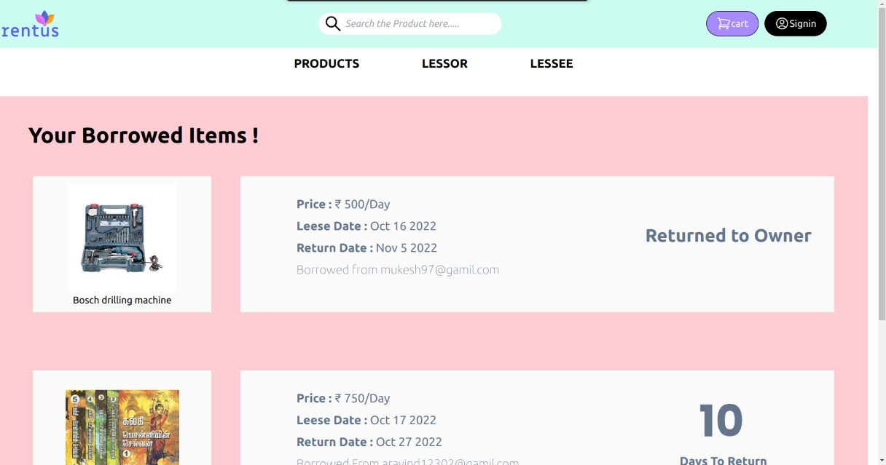

Slide 7
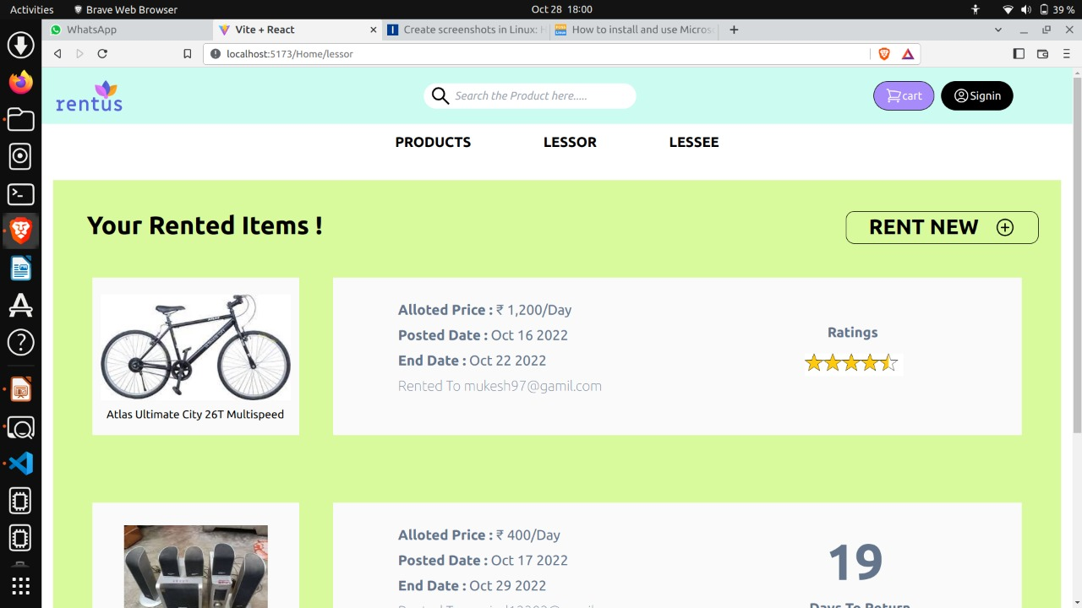

Slide 8
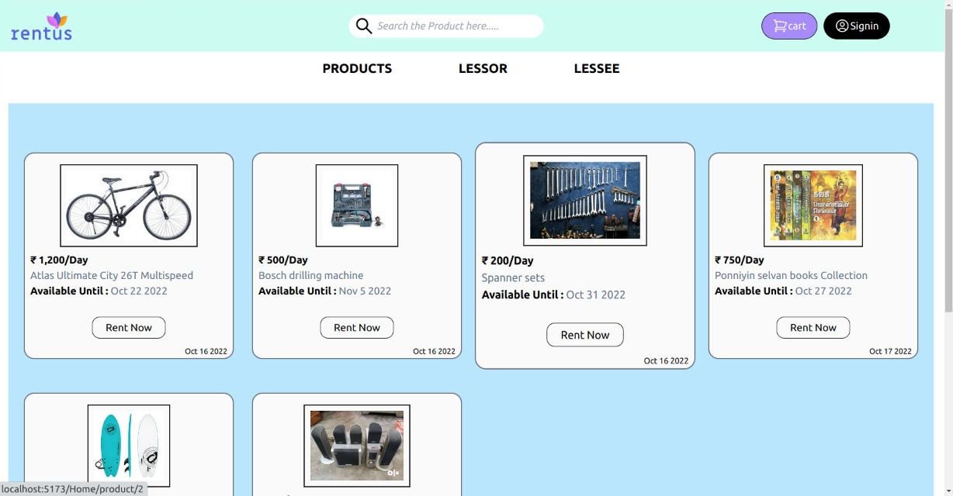

Slide 9
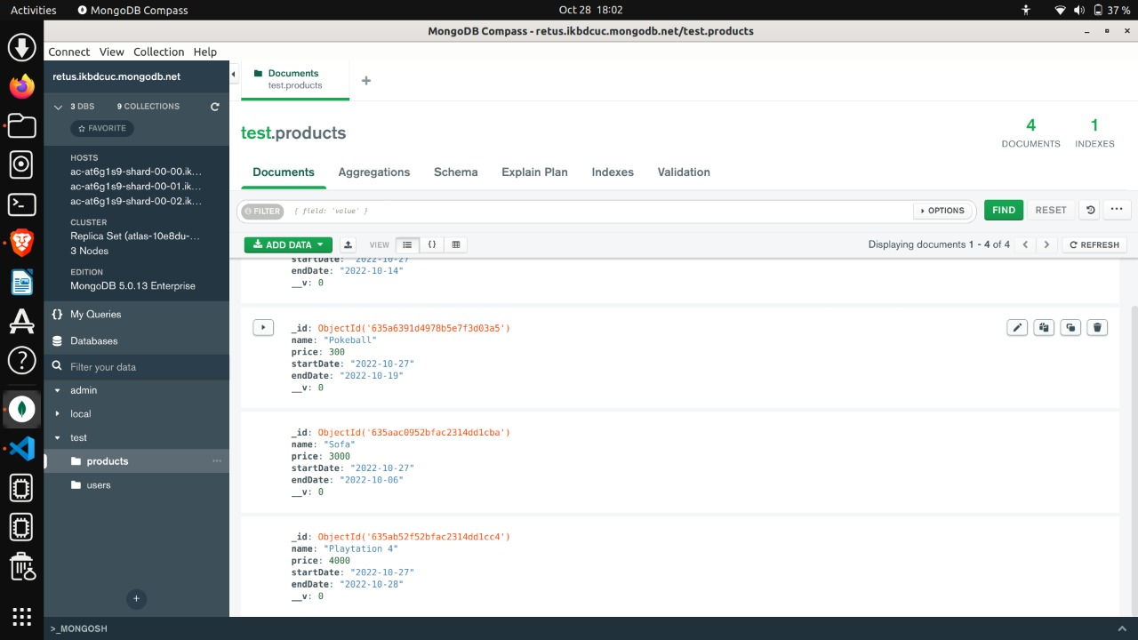

Slide 10
Git Link
LINK: https://github.com/Mathankumar81102/Rentus_app.git

Slide 11
Thank You

